Slide 1
Social Emotional Learning for Students During COVID-19
Facebook Live Capabilities for Life LLC
May 18, 2020

Slide 2
“When physical distancing is deemed necessary, social and emotional connectedness is even more critical.” Karen NiemiPresident & CEOCollaborative for Academic, Social, and Emotional Learning (CASEL)

Slide 4
What is going on with our students?
Ditto everything on the previous slide!
Food insecurity
Housing insecurity
Increase in abuse and neglect
Increase in depression
Increase in suicidal ideation
Disconnectedness

Slide 5
What are Social Emotional Skills?
Protective factors for mental health
Ability to meet social and emotional challenges that impact life, school, self-regulation, relationships

Slide 6
What Can We Do?

Slide 7
How are Social Emotional Skills Taught?
Skills can be learned through whole school approaches, whole classroom approaches, and targeted small group and individual approaches
Must be taught explicitly, however NOT in isolation
Through a range of strategies that address ways to deal with all areas of our social emotional lives
Teacher must model use of skills in everyday situations
A specific evidence based curriculum is better than making it up on your own

Slide 8
Teaching Has To Include…
Role play
Practice with feedback
Discussion in large and small groups
Long term thinking: how is this skill going to help my students in the future?
Scaffolding of the skill so smaller pieces are taught at one time

Slide 9
Teaching Has To Include
Brief, high quality periods of instruction that occur frequently appear to be better than long sessions that are further apart.
https://educationendowmentfoundation.org.uk/tools/guidance-reports/social-and-emotional-learning/

Slide 10
Example
Of a
4 Week Curriculum
https://azulita.org/materials/

Slide 11
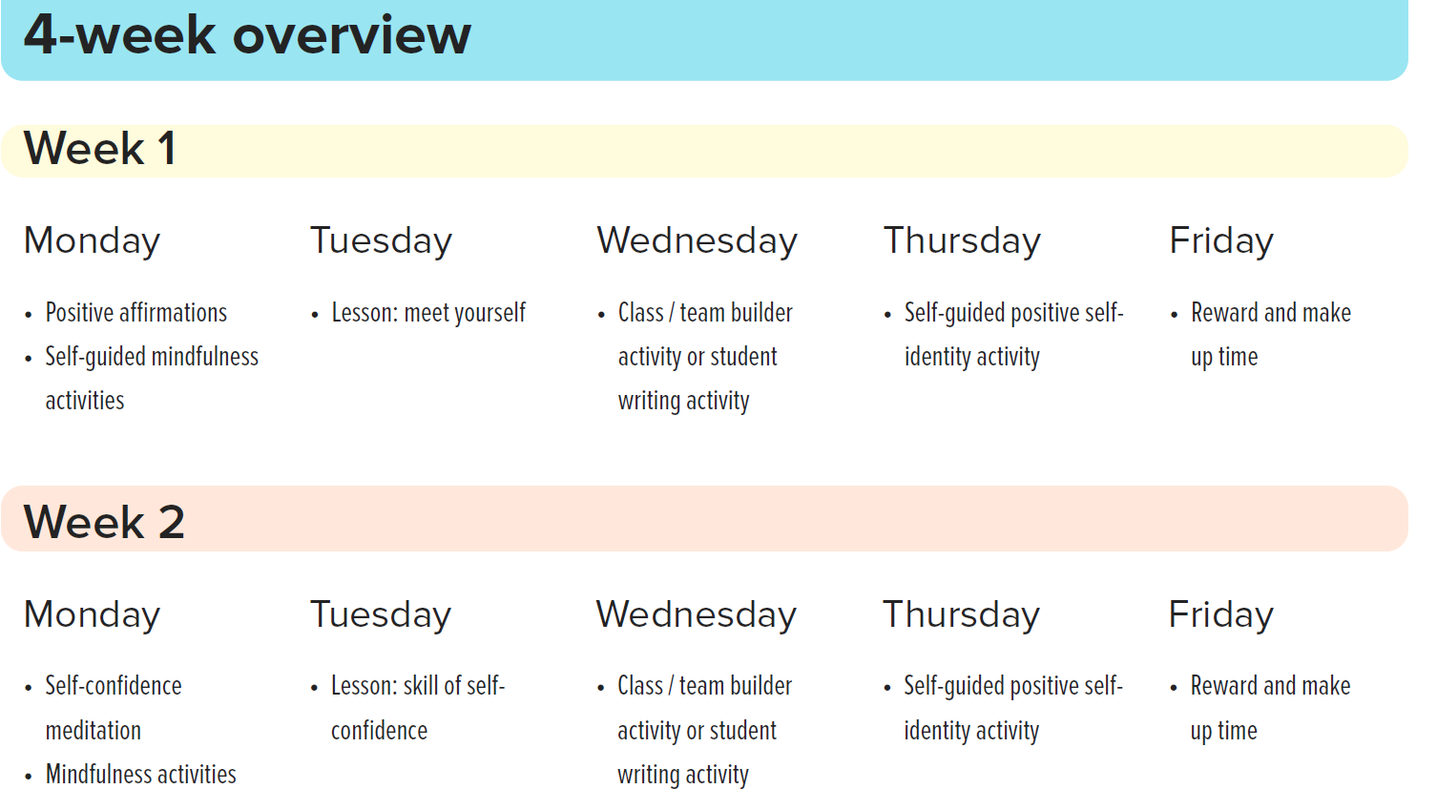

Slide 12
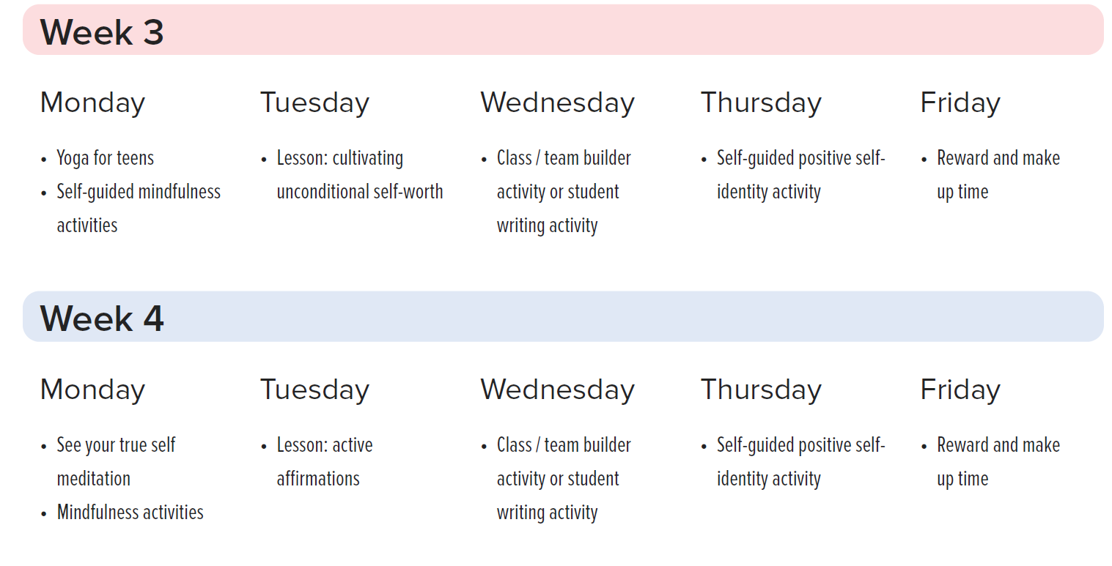

Slide 13
Academic Window
Preventative School Counseling
Uses cognitive development theory, social comparison theory, self-regulation theory, self-determination theory and positive psychological approaches in its solutions and practices
Online collaborative learning environment for students, teachers, counselors, and parents
Motivates students to think about their own behavior

Slide 14
What does Academic Window Provide?
Professional development for all staff
Structured lessons for teachers to use with students
Online confidential surveys for students
Information for teachers, guidance counselors and administration to identify students at risk
Interventions to put in place for all students at the classroom, small group, and individual level
www.academicwindow.com

Slide 15
Until You Can Get A Long-Term Solution…
Remember to work on Connection, Community, and Relationships EVERY time you meet with your students

Slide 16
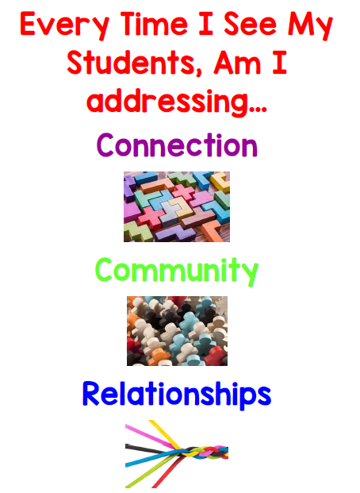

Slide 17
How to stay connected…
Mail
Email
Video
Chat
Phone

Slide 18
How to Maintain Community
Are there games you can play with each other?
Theme weeks
Conversations
Pictures in windows
Chain letter with class
Chain phone calls with positive messages for each other

Slide 19
How to Maintain Relationships
Check in on each other
Learn something fun together
Do an art project together over video
Discuss open ended questions
Share the good, the bad, and the ugly!

Slide 20
What Activities Can I Give My Students?
Journaling
Setting Goals
Problem solving

Slide 21
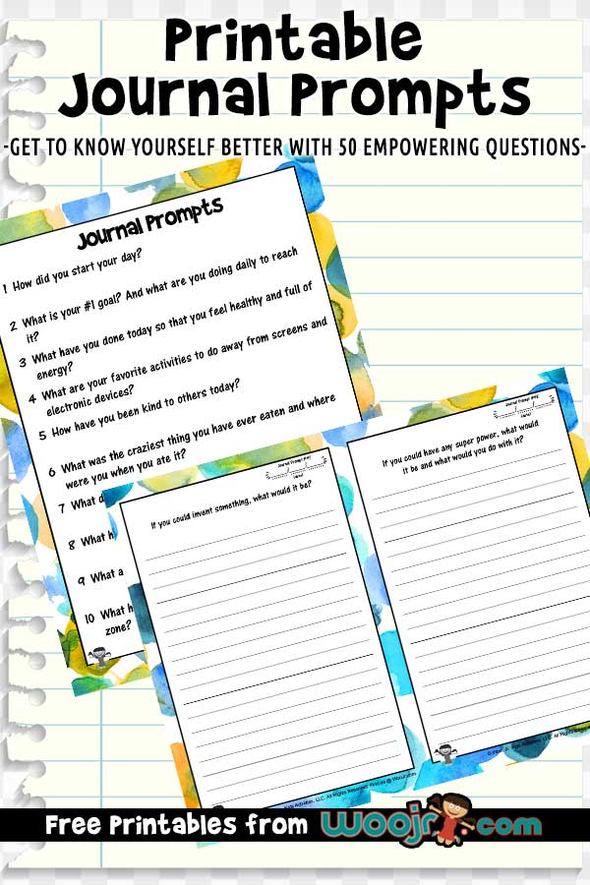

Slide 22
http://www.shopproudtobeprimary.com/

Slide 24
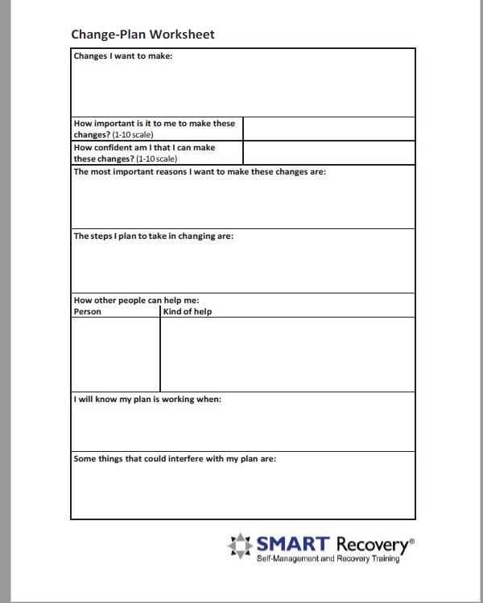

Slide 25
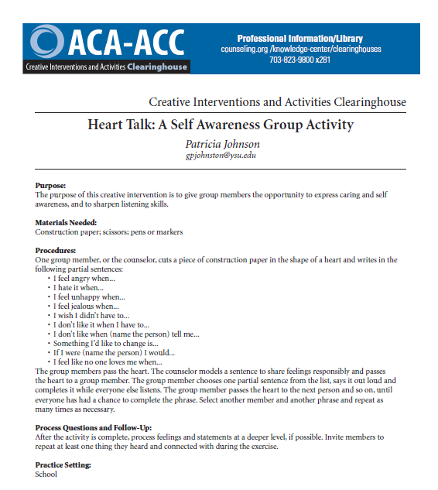

Slide 27
https://www.printableboardgames.net/category/classic

Slide 29
For Your Certificate…
Go to www.capabilitiesforlife.com
Click on the COVID-19 banner at the top of the page
Scroll to the bottom of the page
Enter requested information
This week's code word is ParentTeachemo
Next Week: Scheduling for distance learning

