Slide 1

Capabilities for Life
Facebook Live
June 15, 2020
Becky Chadwick, Josie Brunner & Stacey Breiner

Slide 2
Ultimate Transition Strategy
If you can teach a skill,
Teach it
If you can’t teach the skill,
Adapt it
If you can’t adapt the skill,
Find someway around it
If you can’t find some way around it,
Teach others to cope.
Peter Gerhardt

Slide 3
Ultimate Transition Strategy Applied to Parents and Caregivers

Slide 4
What are the tasks that we must do?
Listed on our worksheet

Slide 5
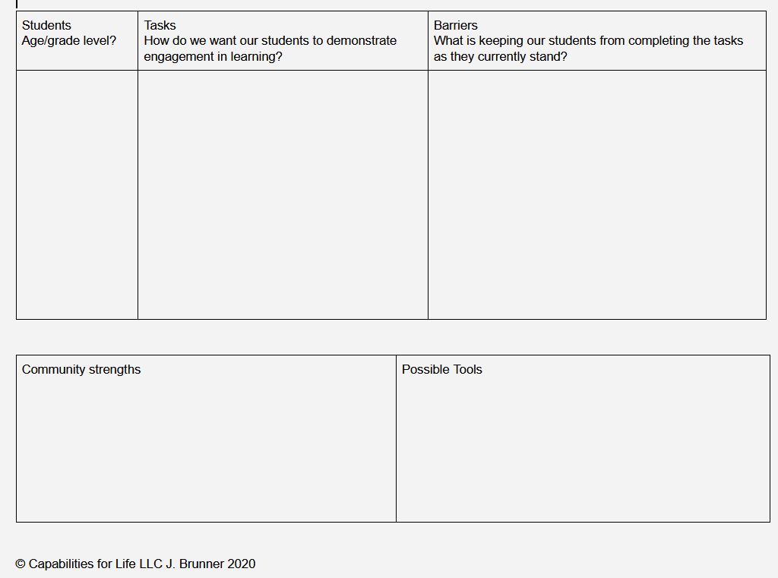

Slide 6
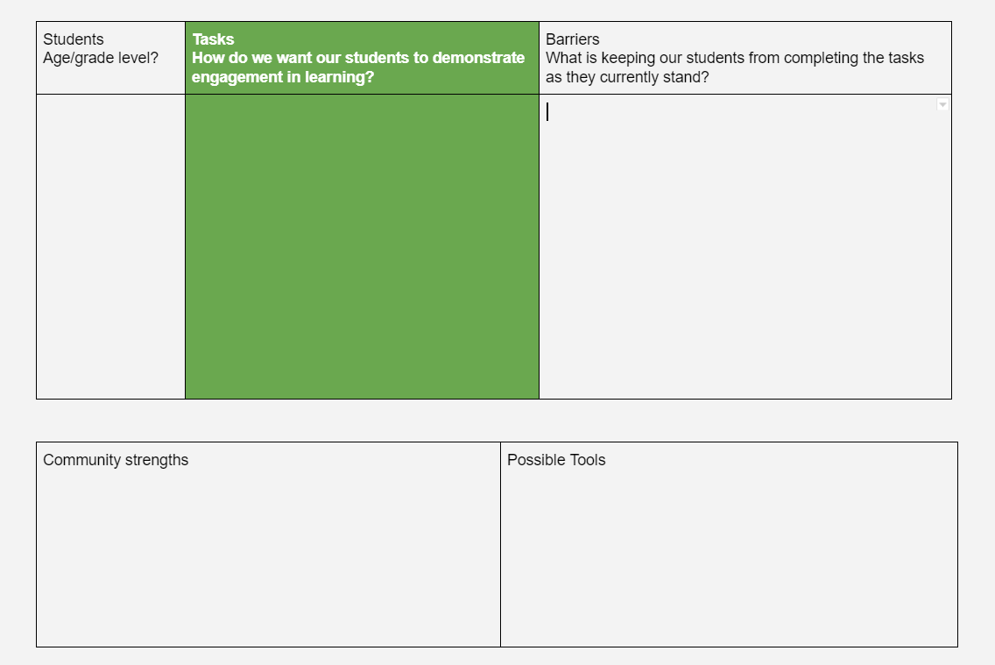

Slide 7
Specific

Slide 8
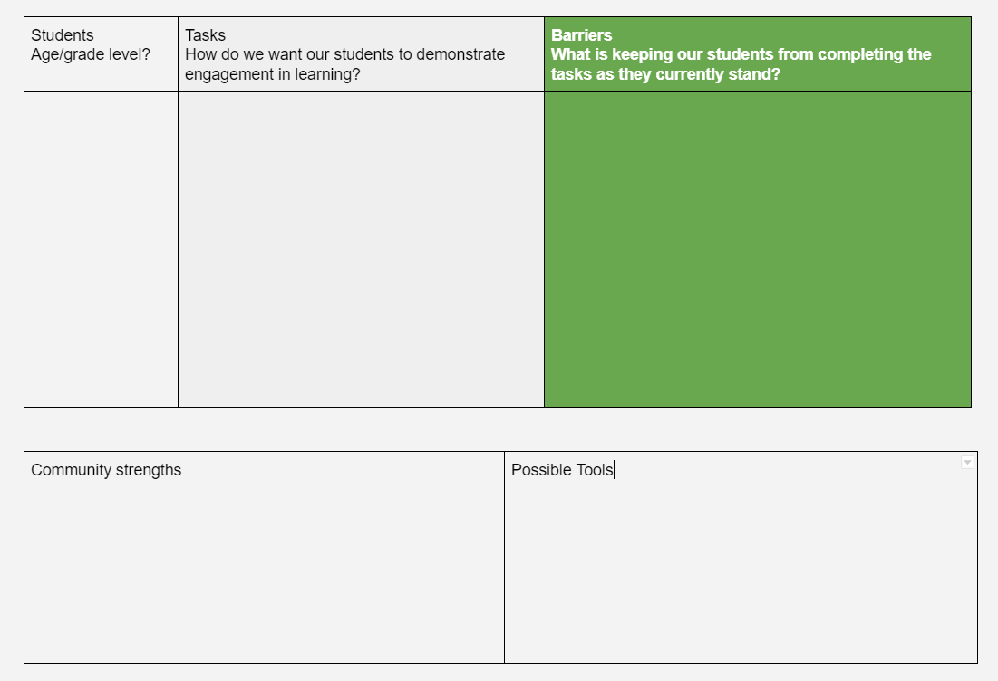

Slide 9
Lack of parent participation

Slide 10
Lack of parent participation
Is the task specific or general?

Slide 11
Lack of parent participation
Is the task specific or general?
Does the parent know how to access the task?

Slide 12
Lack of parent participation
Is the task specific or general?
Does the parent know how to access the task?
Does the parent know how to do the task?

Slide 13
Lack of parent participation
Is the task specific or general?
Does the parent know how to access the task?
Does the parent know how to do the task?
Does the parent have the time/focus for the task?

Slide 14
Lack of parent participation
Is the task specific or general?
Does the parent know how to access the task?
Does the parent know how to do the task?
Does the parent have the time/focus for the task?
Can the parent manage their child’s behavior?

Slide 15
Lack of parent participation
Is the task specific or general?
Does the parent know how to access the task?
Does the parent know how to do the task?
Does the parent have the time/focus for the task?
Can the parent manage their child’s behavior?
Is the task “worth it” ?

Slide 16
Lack of access to technology?

Slide 17
Lack of access to technology?
How did we manage this issue when the students were physically in school?

Slide 18
Lack of access to Wi-Fi?

Slide 19
Lack of access to Wi-Fi?
Do the students have technology options that do not require internet?

Slide 20
Lack of access to Wi-Fi?
Do the students have technology options that do not require internet?
How can they report completed assignments without internet?

Slide 21
