Slide 1

Capabilities for Life
Prompt to Independence
July 6, 2020
Becky Chadwick, Josie Brunner & Stacey Breiner

Slide 2
Ultimate Transition Strategy
If you can teach a skill,
Teach it
If you can’t teach the skill,
Adapt it
If you can’t adapt the skill,
Find someway around it
If you can’t find some way around it,
Teach others to cope.
Peter Gerhardt

Slide 3
If you don’t know where you are going…..
You will end up someplace else!
Yogi Berra

Slide 4
Instructional methods
Errorless Learning
Direct Instruction (I Do! We Do! You Do!)
Both instructional methods begin with a most to least prompt hierarchy with planned fading to independence in a task.

Slide 5
Errorless learning
Ensures children always respond correctly.
As each skill is taught, students are provided with a prompt or cue immediately following an instruction.
The immediate prompt prevents any chance for incorrect responses.
Immediate prompting ensures that a child may only respond correctly.

Slide 6
direct instruction
direct instruction (di) is a specific model of instruction used to accelerate student learning by maximizing efficiency in the design and delivery of instruction.
di ► skill acquisition ► practice ► mastery
University of Oregon

Slide 7
di Format
Objective
Model – “I do”
Lead – “We do”
Test – “You do”
Re-test
Error correction
Much of the interaction follows a script.

Slide 8

EXPLICIT INSTRUCTION: What the Research Says….
Instruction which is explicit positively impacts student achievement and independent, self-regulated learning.
Notes:
Effective teachers
Make goals, objectives, & expectations explicit
Make instructional content explicit
Check for student understanding
Guide students in initial practice
Provide systematic feedback reinforcement and corrections
Monitor and provide instruction for functional independent work
Provide practice until fluent plan cumulative review
Make the structure of lesson presentation explicit
Demonstrate the difference between explicit and implicit with dance instructions
The electric slide
Starting with the right foot
Three steps right-tap left
Three steps left-tap right
Three steps back tap right foot lead
Lean tap front (left)
Lean tap back (tight)
Three step – up, back, up, kick, quarter turn
Start again

Slide 9
Explicit Instructional Format
Start by reviewing what has been taught.
Describe goals of lesson.
Present new material in small steps, using clear
instructions and modeling (“I do”).
Provide repeated opportunities for students
to practice with feedback (“We do”).
Continue providing practice until independent
performance (“You do”).
Provide review (“You do over time”).
Source: Rosenshine (1986).

Slide 10
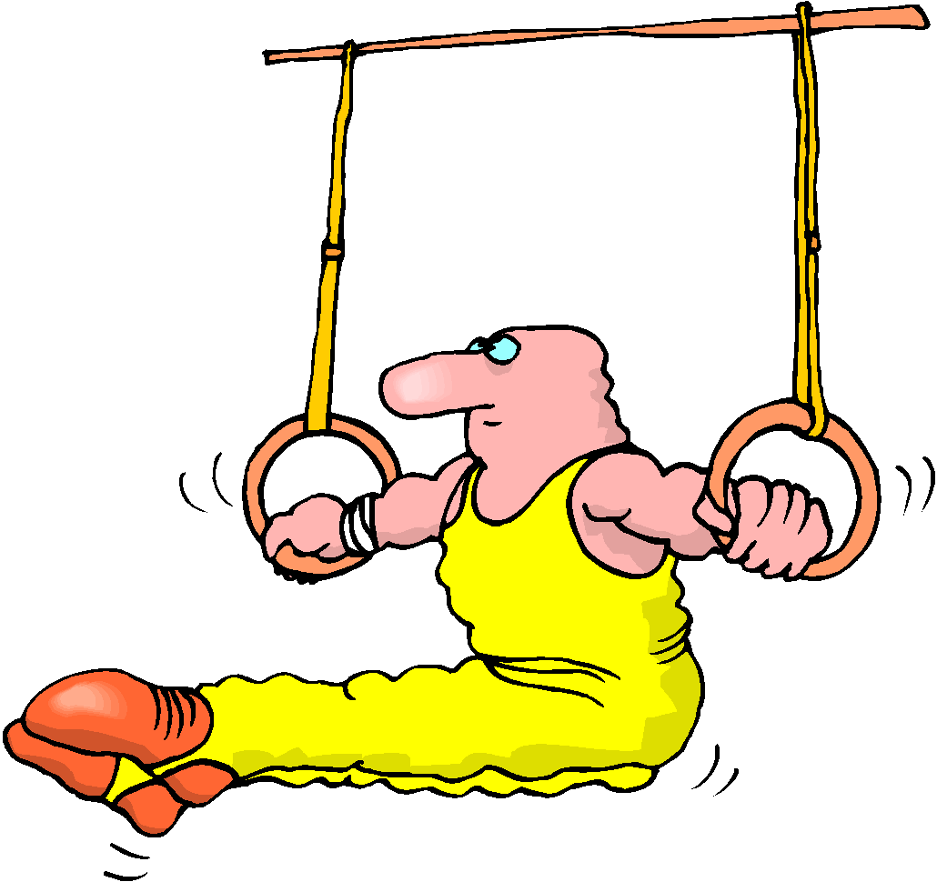
Explicit Instruction Model
Controlled Practice
I do!
  model/demonstration
We Do!
  high guided practice
  low guided practice
You Do!
  independent practice

Slide 11

Prompting
What is a prompt?
Why do we prompt?
How do we prompt?
What are the biggest mistakes we make with prompting?

Slide 12
Prompting procedures include
Any help given to learners that assist them in using a specific skill.
These procedures are often used in conjunction with other evidence-based practices including time delay, errorless learning, and reinforcement.
Prompting procedures are integral to learning and are generally given by an adult or peer before or as a learner attempts to use a skill
http://autismpdc.fpg.unc.edu/content/prompting

Slide 13

Prompts are generally given by an adult or peer before or as a learner attempts to use a skill.

Slide 14

Hand over Hand:
This is the most invasive of the prompts, and is often only required for the students who are most physically disabled and intellectually disabled.
The teacher actually places his or her hand over the student's hand.
It works well with young students on the autism spectrum, older students with unfamiliar tasks like sweeping, and even younger students with immature and undeveloped fine motor skills.
Hand over hand can be faded by lightening your touch to a simple touch on the back of a hand or arm to guide the student though the task.

Slide 15

Physical Prompts:
Hand over hand is a physical prompt, but physical prompts can include tapping the back of a hand, holding an elbow, or even pointing.
Physical prompts may be accompanied by verbal prompts. As the verbal prompts stay in place, the teacher fades the physical prompt.

Slide 16

Verbal Prompts:
These are the most familiar prompts.
We tell the student what to do: sometimes step by step, sometimes with more detail.
Of course, if we talk all the time, our prompts get ignored.
You can also design verbal prompts to fade from most complete to least complete.
Example: “Bradley, pick up the pencil. Bradley, put the point on the paper. Circle the correct answer. Good job, Bradley: Now, let’s do number 2. Find the correct answer, etc. . . .” Faded to: “Bradley, you have your pencil, your paper and we have done these before. Please circle each answer and put your pencil down when you are done.”

Slide 17

Gestural:
These prompts should begin with a verbal prompt:
They are easy to fade and are the least invasive.
Be sure you don’t become so used to your verbal prompts that all you’re doing is talking for the sake of talking!
Shorten those prompts and trust the gesture, whether it’s pointing, tapping or even winking.
Be sure the student knows what you are requesting with the prompt.

Slide 18

Gestural prompts are especially successful with kids with developmental or behavioral problems.
Example: Alex sometimes forgot and would drool. His teacher, would touch her chin with her forefinger and say “Alex swallow” to remind him to swallow: She was able to fade the verbal to a gestural prompt only, so all she had to do was move her hand a certain way, and Alex remembered to swallow.
http://specialed.about.com/od/autismandaspergers/a/Prompts-That-Support-Instruction-And-Independence.htm

Slide 19
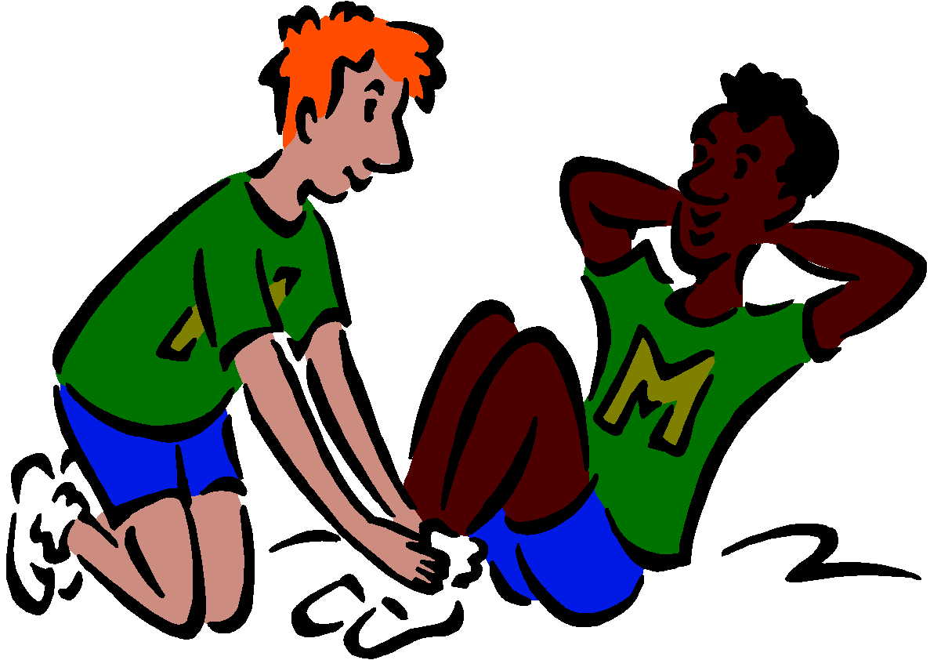




Let’s Look
There are a variety of prompt hierarchy’s.
Choose the right one for the student and the instructional method you are using!
Instructional method dictates what hierarchy to use.

Slide 20
Error Correction
Mastered (Easy) Items
If… | Then…
Student makes incorrect response or does not respond within 2-3 seconds | Prompt correct response Re-present and prompt immediately Re-present and fade prompt 2-4 easy tasks Re-present and wait 2-3 seconds to prompt

Slide 21
Error Correction
Target (Hard) Item
If… | Then…
Student makes incorrect response during the daily probe for that item or if you think student may make an error…. | Present and prompt immediately Re-present and fade the prompt 2-4 easy tasks Re-present and wait 2-3 seconds to prompt 5. Repeat if necessary

Slide 22
Error Corrections
Put Simply
  My Turn
  Do it with me
  Your turn
  Do another problem
  Go back to the problem that a mistake was made on
  Repeat as needed

Slide 23


Next Week…Prompting for Communication
Please Like and Share our video
Confirmation Code for this week is
PromptJuly
Go to www.capabilitiesforlife.com to request a certificate

