Slide 1

Capabilities for Life
Sequencing Skill Instruction: New Skills
June 29, 2020
Becky Chadwick, Josie Brunner & Stacey Breiner

Slide 2
Ultimate Transition Strategy
If you can teach a skill,
Teach it
If you can’t teach the skill,
Adapt it
If you can’t adapt the skill,
Find someway around it
If you can’t find some way around it,
Teach others to cope.
Peter Gerhardt

Slide 3
If you don’t know where you are going…..
You will end up someplace else!
Yogi Berra

Slide 4
Instructional Formats
  “A format specifies the way that teachers will present each example, explanations that they will give, questions that they will ask, and corrections that they will use. Formats are carefully designed to be clear and concise, to help students focus on the important aspects of items, to provide appropriate support for students’ developing skills and, above all, to communicate clearly with students.”
  Marchand-Martella, Nancy E., Slocum, Timothy A., Martella, Ronald C.. Introduction to Direct Instruction. Pearson, Boston. 2004. 17-18.

Slide 5
Instructional Formats
  Why consistency in wording?
    Helps the students focus on content
    Communication is clear
    Helps teachers use effective, well-designed and precise language
    Gives appropriate support for students
  Marchand-Martella, Nancy E., Slocum, Timothy A., Martella, Ronald C.. Introduction to Direct Instruction. Pearson, Boston. 2004. 17-18.

Slide 6
Mastery Learning: What is it?
  Systematic instructional approaches that include the following teaching activities:
    Diagnosis: accurate predicting a student’s future performance based upon present and past performance
    Prescription: providing appropriate tasks for student based upon the diagnosis
    Orientation: clarifying each learning task for a student (what is to be learned and how it is to be learned)
    Feedback: consistently providing information to the student regarding his/her progress on a task
    Correction: providing supplemental instruction for a student when insufficient learning occurs
    Technical Report No. 5 produced for the National Center to Improve the Tools of Educators, University of Oregon. Research Synthesis of Effective Teaching Principles and the Design of Quality Tools for Educators. Ellis, Edwin S. Worthington, Lou Anne. January 13, 1994.

Slide 7
Sequencing of Skills
  Prerequisite skills for a strategy should be taught before the strategy itself.
  Instances consistent with the strategy should be taught before the exceptions
  Easy skills should be taught before more difficult skills.
  Strategies and information that are likely to be confused should be separated in the sequence.

Slide 8


EFFECTIVE INSTRUCTION
1. I DO
Demonstrate
2. WE DO
Guided practice
*High guided practice
*Low guided practice
3. YOU DO
Independent practice
1. Model
2. Lead
3. Test

Slide 9
Five principles for sequencing and ordering examples to communicate clearly
  The wording principle: Use the same wording on all items. This helps students focus attention to details of the examples by reducing distraction or confusion
  Marchand-Martella, Nancy E., Slocum, Timothy A., Martella, Ronald C.. Introduction to Direct Instruction. Pearson, Boston. 2004. 17-18.

Slide 10


The Wording Principle: YES!
  A picture of a man on the door means men’s bathroom.
  A picture of a woman on the door means women’s bathroom.

Slide 11
The Wording Principle: NO!
  A picture of a man on the door means men’s bathroom.
  When there is a picture of a woman on the door it means that it is a woman’s room.

Slide 12
The Wording Principle: YES!
  Get ready to spell some words that contain the sound /e/ spelled with the letters e-a.
  Spell leave. Get ready (signal)
L-e-a-v-e.
  Spell repeat. Get ready (signal)
R-e-p-e-a-t.
  (Repeat step 3 for : speak, leader, year)

Slide 13

The Wording Principle: NO!
  Get ready to spell some words that contain the sound /e/ spelled with the letters e-a.
  Spell leave. Get ready. (signal)
L-e-a-v-e
  Now we are going to spell another word. Try to spell repeat
  Let’s go (no signal)
r-e-p-e-a-t

Slide 14
The Setup Principle
  Examples and non-examples selected for initial teaching of a concept should share the greatest possible number of irrelevant features.
  Marchand-Martella, Nancy E., Slocum, Timothy A., Martella, Ronald C.. Introduction to Direct Instruction. Pearson, Boston. 2004. 17-18.

Slide 15


The Setup Principle
  YES!!
  This is on.
  This is not on.
  NO!!
  This is on.
  This is not on.

Slide 16



The Set Up Principle
NO
YES
  Stop: to end an action, activity, movement or event or to make something end.
  This is stop
  This is not stop
  Stop: to end an action, activity, movement or event or to make something end.
  This is stop
  This is not stop

Slide 17
The Set Up Principle
  Completely depressing the brake in your car.
        Stop or not stop
  Pressing the gas pedal of your car.
        Stop or not stop
  Running and then falling down.
        Stop or not stop
  Continuing to move forward.
        Stop or not stop
  The batteries in the radio control car die.
        Stop or not stop

Slide 18
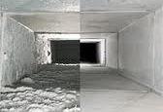
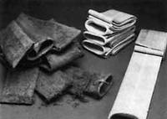

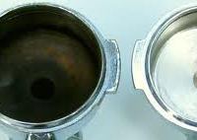
The Set Up Principle
Dirty: covered in or marked by an unwanted substance
This is dirty. This is not dirty

Slide 19
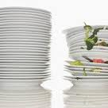
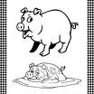
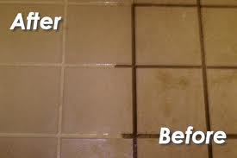
This is not dirty.
This is dirty.
This is not This is dirty.
dirty.
This is not dirty. This is dirty.

Slide 20
The Difference Principle
  Illustrates the limits or boundaries of a concept. Shows examples and - that are similar to one another except in the critical feature that indicates they are different. Most effective when items are next to one another.
  The difference needs to be just enough to make it different. Want children to know when item goes from following the rules to no longer following the rules.
  Marchand-Martella, Nancy E., Slocum, Timothy A., Martella, Ronald C.. Introduction to Direct Instruction. Pearson, Boston. 2004. 17-18.

Slide 21

The Difference Principle
  YES!!!!
  This line is horizontal
  This line is not horizontal.
  NO!!!!
  This line is horizontal
  This line is not horizontal.

Slide 22

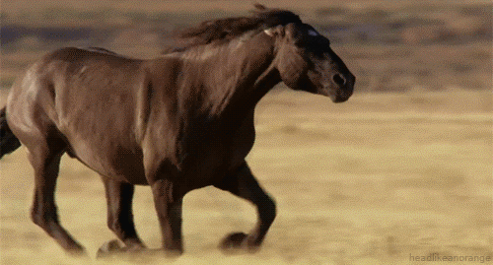
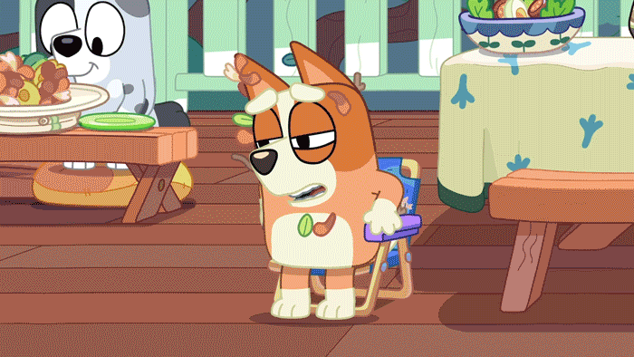
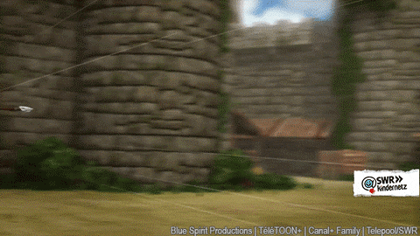




The Difference Principle: Stop

Slide 23
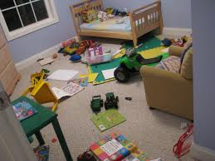
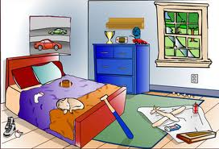
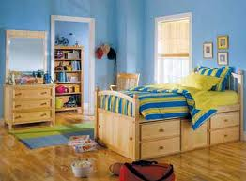
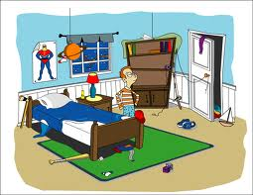
The Difference Principle

Slide 24
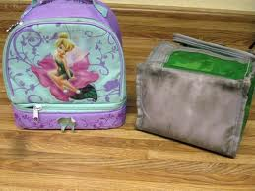
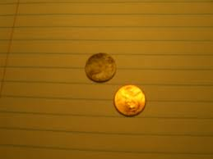
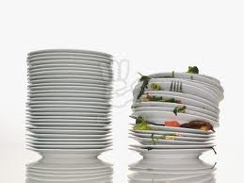
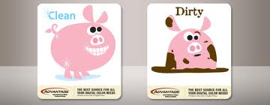

Slide 25
After students have mastered initial instruction, slowly add examples that are slightly different in:
  Wording
  Location
  Timing

Slide 26
The Sameness Principle
  Show the range of variation of the concept. Examples of the concept that differ from one another as much as possible but still illustrate the concept and indicate that they are the same. This is intended to foster generalization to unfamiliar concepts.
  Marchand-Martella, Nancy E., Slocum, Timothy A., Martella, Ronald C.. Introduction to Direct Instruction. Pearson, Boston. 2004. 17-18.

Slide 27




The Sameness Principle
This is a bathroom sign.
This is a bathroom sign.
This is a bathroom sign.
This is a bathroom sign.

Slide 28



The Sameness Principle: Non-example
This is a sign for a bathroom.
This is a sign for a bathroom.
This is a sign for a bathroom.

Slide 29







Testing Principle: Examples
Is this a bathroom sign?
Is this a bathroom sign?
Is this a bathroom sign?
Is this a bathroom sign?
Is this a bathroom sign?
Is this a bathroom sign?
Is this a bathroom sign?
Is this a bathroom sign?

Slide 30
The Sameness Principle: Vocabulary
  Clock: an instrument in a room or building that shows the time.

Slide 31








The Sameness Principle
Yes! NO!
This is a clock
This is a clock
This is a clock
This is a clock
This is a clock
This is a clock
This is a clock
This is a clock

Slide 32


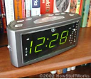




Testing Sameness Principle
Is this a clock?
Is this a clock?
Is this a clock?
Is this a clock?
Is this a clock?
Is this a clock?
Is this a clock?
Is this a clock?

Slide 33

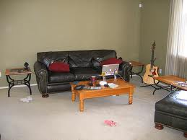
The Sameness Principle: Vocabulary
Dirty: covered in or marked by an unwanted substance
Is this dirty? Is this dirty?

Slide 34
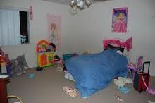

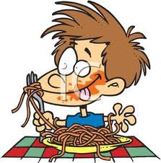
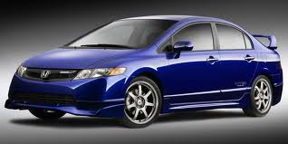


Is this dirty?
Is this dirty?
Is this dirty?

Slide 35
Next Week…Sequencing Instruction: Prompting
Please Like and Share our video
Confirmation Code for this week is
Skills29
Go to www.capabilitiesforlife.com to request a certificate

